Slide 1

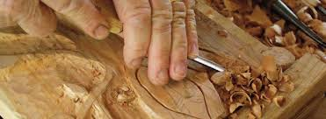
Intro to File Carving
UofSC Cybersecurity Club - SWGN 2A14
April 12th, 2019 6:30 P.M.
Austin Staton
Notes:
This presentation is SPECIFIC to hard disk images. This can be done over Network traffic; however, I am not that advanced yet.

Slide 2
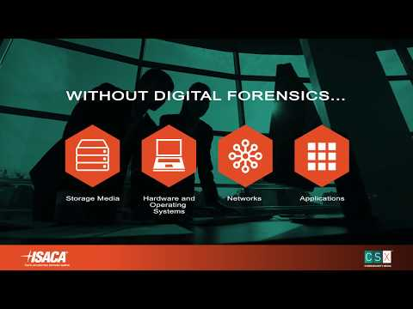
Forensics Overview

Slide 3
What are Forensics?
Computer Forensics - The application of the scientific method in reconstructing a sequence of events involving computers and information.
- U.S. Naval Academy
Notes:
I learned about forensics during my time at South State Bank. These techniques are implemented on infected devices and drives. Also can be implemented if employees are breaking a computer use agreement. Used with Osama Bin Laden and his drives.

Slide 4
What is a File?
“A file is a container in a computer system for storing information.”
-Techopedia

Slide 5
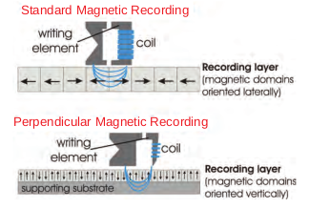
How Are Files Stored on a Disk?
When a strong magnetic field is applied across a small area of the disc, it causes the atoms in that area to align along the orientation of the field, providing the mechanism for writing bits of data onto the disc. Conversely, by detecting the aligned field, data can be read back from the disc (Ulaby).
Notes:
We can conclude that files can be extracted from an “erased” disk. Persistent Data vs. Volatile data

Slide 6
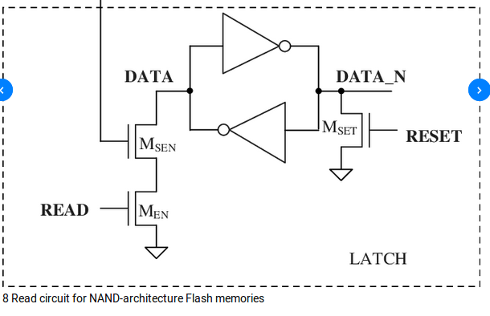
The Case of SSDs
SSDs store data in NAND flash (i.e. “flash memory) circuits.
This is different from the transistors in DRAM because the NAND flash stores electrons/charge without external power supplies.
This means non-volatile data is stored.

Slide 7
Magic Numbers
File Signatures (a.k.a. “Magic Numbers”) identify the leading, and occasionally trailing, bits of a file.
Example:
File Type | Leading Bits | Trailing Bits
JPEG | 0xFFD8FFE3 | 0xFFD9
https://filesignatures.net/index.php
Notes:
Hexdump the .doc file with the .jpeg in it.\
0002240 addr ;

Slide 8
“Deleting” Files
Files must be overwritten to be truly deleted. Otherwise, the data remains intact, but there is no organization/structure to the data.
Meaning, the computer recognizes the “deleted space”; but, the space is waiting to be reused.

Slide 9
File Carving
File Carving uses the concepts of Magic Numbers to search for patterns in bits. With the patterns, portions of data are then extracted. These portions of data are then placed in a new container, which recreates the file.
The carve does not rely on any specific file system (FAT32, ext3, ext4) to execute effectively.

Slide 10
Demo
We will be using a tool called “Scalpel.” This tool is a modified successor to the tool, “Foremost”, developed by the USAF Office of Special Investigations.
$ sudo apt-get install scalpel
Retrieve the disk image:
$ wget https://cse.sc.edu/~ajstaton/nist_docs.dd

Slide 11
Demo (cont.)
Scalpel uses a configuration file that allows users to select exactly what files they would like to have retrieved.
$ sudo vi /etc/scalpel/scalpel.conf
Once files (PDFs) have been specified, run the scalpel command on the retrieved disk image.
$ scalpel nist_docs.dd

Slide 12
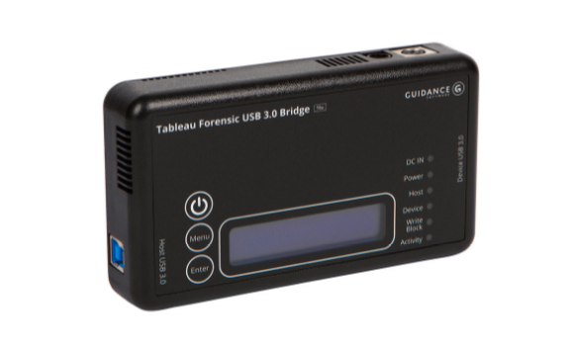
Limitations
By no means is File Carving a perfect plan for recovering all data from a disk. The structure of the data can be altered with:
Fragmented Files (moves bits to different locations)
Compressed Files (removes non-essential bits
Disk Encrption
Identifying a source of malware on an infected machine with file carving has its risks. Ensure that you are in a secure environment.

Slide 13
Real-World Examples
Osama Bin Laden’s compound was raided in 2011. There were 10 HDDs, among 5 computers. Forensics were used to gain other intel.
In 2016, Hillary Clinton’s personal emails were recovered by the use of file carving.

Slide 14
Sources
https://www.us-cert.gov
HIGHLY recommend: https://www.usna.edu/Users/cs/wcbrown/courses/si110AY13S/lec/l30/lec.html

